Slide 1
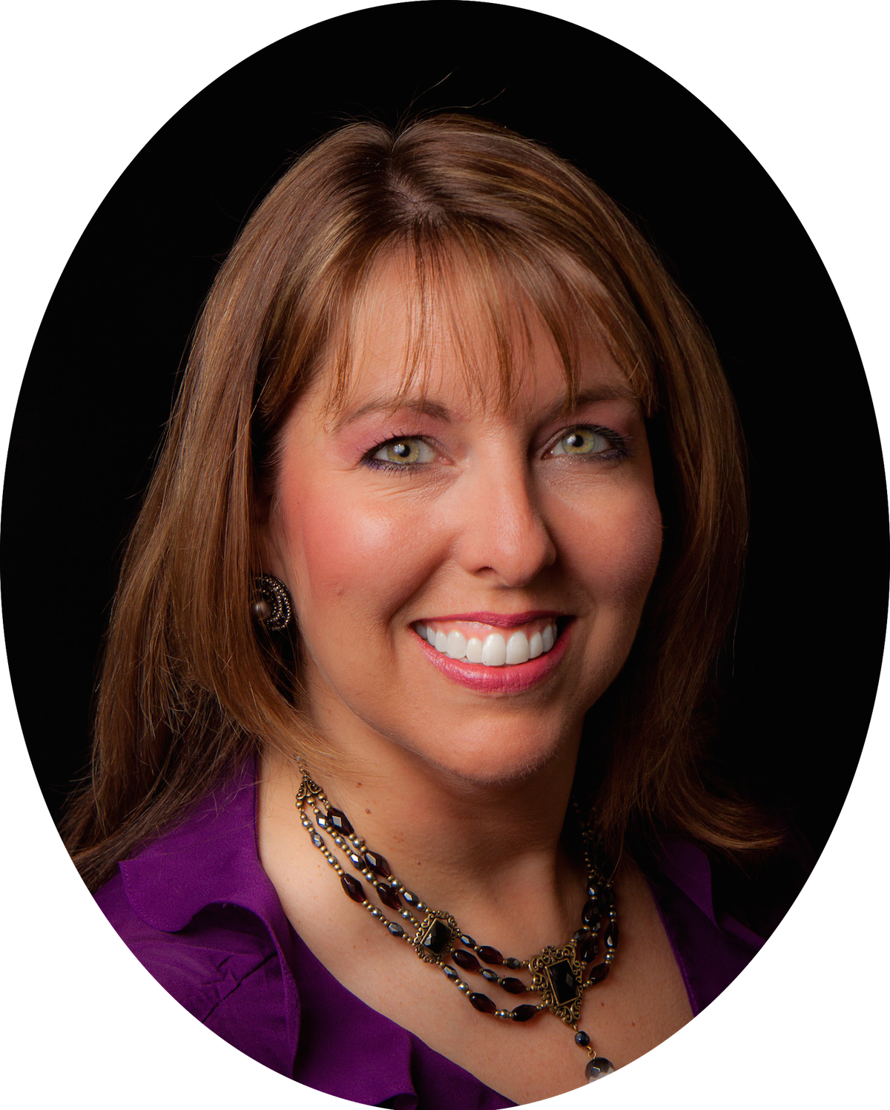
Frontline News
On The Horizon
In this issue:
Christine Casten
On the Horizon
Facebook Live
Event Reminder
Website Upgrades
Sharon Rudolph
Unveiled Faces
Angela Taylor
Our Weapon of
Warfare
Fire Starters
Training Focus:
Pacing
Member Spotlight:
Linda Smallbones
Who We Are
By Christine Casten
Executive Director of TWC
Welcome Back from Worship Ebb!
Welcome to our new TWC Training Year!
Worship Ebb created some great space for refreshing and time with the Lord. Let’s cover what’s happening now in TWC and what seems to be happening prophetically in the Church.
Praying into 2019-2020, we see God targeting many things in our Warrior Hearts. Look for the Firestarter question on “What did God show you during Worship Ebb?” on Facebook today…Feel free to share what He is showing you personally, for TWC and/or for the body of Christ as a whole.
Let’s also start this training year off right! Join me on our FB live call tomorrow so we can pray the Training Days Crafted Prayer together. Nothing is more valuable than to saturate this year in prayer!
2019-2020
Each Training Year, God puts His favor on 1-3 specific areas for what He wants to draw out, create and/or establish in TWC. Right now, the one that is front and center is about developing relationship with each other.
We have already embraced what God is opening before us as a community and focused on getting that started in the 2017-2018 Training Year. In 2018-2019 we focused on continuing to develop, upgrade and revise our training. Understand, these two things continue. But, now our main focus is on building closer connections among our warriors.
©2019 The Warrior Class ©2019 Frontline This training journal is only for The Warrior Class members who may print it for personal use or share via email.
Written permission is required for any other use or purpose for part or all of its contents.

Slide 2
Let’s remember, it takes ALL of us committing to these connections for these relationships to establish and build. We’ve seen over and over that those who have connected with others in TWC have had the most accelerated and lasting growth. So, we know warrior buddies are a powerful force in our lives!
We encourage everyone to find a small group of warrior buddies to travel within their training journey.
However, we also understand the challenge of doing this in an online/virtual landscape. So, we are looking for creative solutions that open us up to new exploration and connection -- without the constraints we found in the past in a traditional small team format.
Something New
In the church and world, most groups form through proximity (location), emotional need (such as similar challenges or hurts experienced), or through functional connections (what we do). We feel there is something else God has on hand to help us connect in TWC!
What this means is we get to think outside the box! It’s time to re-imagine! What can we develop and what will God open up for us? What does our set of running mates look like? How can we connect and incorporate what is a passion on our heart and the hearts of other warriors? Hmmm…I think we just walked through a gate into wide open spaces!
We could easily set up something that has proven to “work” in the past, but as pioneers, we understand God wants us to reach for what’s possible. We are a community on the cutting edge of what is coming.
Not Just for Us
Our desire to scout ahead and explore new territories, create the map in unknown lands and encourage individuals to rise into their potential, means….
we know God has something just On The Horizon that will be special and unique to us.
This process will bring more transformation to us and, ultimately, will also help us
©2019 The Warrior Class ©2019 Frontline This training journal is only for The Warrior Class members who may print it for personal use or share via email.
Written permission is required for any other use or purpose for part or all of its contents.

Slide 3
partner with God as He transforms the Church! It’s the process that makes us rich and enriches all we meet!
A few days ago, I spoke with a leader in the body of Christ. He travels and connects with many churches throughout the US and world and has been in ministry for many years. As we talked, he shared what he senses in this time and season. He said he felt the Church has been in a similar season since the 1700s. But now, that season has ended and a new one is beginning. We are entering into something completely different.
As I’ve spoken with other Christian leaders, I have heard similar things: “Something is changing.” “The Church is shifting.” “The way we’ve done things needs to change.” “I have a dissatisfaction with status quo and know I need to shift, but I’m not sure how or what that looks like.” “I could settle for the way I’ve always done things and could do them well, but I know I’m missing something and am not sure what ‘differently’ means or looks like.” We’ve heard comments like these over and over!
God also has a lot of groups like us out there stretching beyond, tapping into the creativity of God and exploring just what is possible. Right now, these groups are somewhat isolated because they just don’t know how to connect.
I believe many of us, TWC WARRIORS, are in these groups and can help us connect them with us and with other groups who
are like minded. No territorialism, no
walls…just encouragement to rise into
the identity God has for that group. We know, in that process, we will be blessed by what God’s given them and that synergy will help others be catapulted, too.
We’ve watched the Lord open doors for our warriors in the past couple of years. Some beat against the walls of that area for years and had never seen it budge. But then, suddenly, the doors opened and they stepped into seeing those prayers come to life. We carry important perspectives for this new era. God is positioning us to be ready for those open doors!
You know others who want to train and have a passion to find what we have in TWC. Don’t be shy, invite them to be a part of The Warrior Class.
We are passionate to help the body prepare
and rise in this time. The time is now. You need to understand, our passion and part of why TWC is here in this time and season is to help all we can connect, transform, and re-imagine in this new era!
The Warrior Class is not made up of one type of warrior. We are not a cookie cutter community. THANK THE LORD! We are passionate about seeing each of you rise into the more God has on hand. We do this through our training and through connecting to each other. Sure, it might be messy at times…but that doesn’t scare us…it excites us. God created the heavens and earth out of the informed, creative process…and He’s creating a new thing now!
©2019 The Warrior Class ©2019 Frontline This training journal is only for The Warrior Class members who may print it for personal use or share via email.
Written permission is required for any other use or purpose for part or all of its contents.

Slide 4

We were wired to connect because, as God positions us in our areas of influence, we have the support and encouragement of fellow warriors. Together, our Warrior Buddies help us focus on God and stay connected to our warrior mindsets of seeing life from heaven to earth.
All throughout the 8 years of TWC’s existence, we asked to train for the more God has on hand. We wanted to be ready to partner with this next move of God. It’s here and it’s time. Embrace your training and dive as deep as possible into God’s heart. Our ability to take/hold ground and fight the spiritual battles will equal how well we have embraced our training process and deeper relationship with God. He is on the move. Let’s run with Him!
Facebook Live Event!
Saturday, July 13, 2019
9AM PDT
You can find the Training Days Crafted Prayer
in the Event post on our Facebook page.
©2019 The Warrior Class ©2019 Frontline This training journal is only for The Warrior Class members who may print it for personal use or share via email.
Written permission is required for any other use or purpose for part or all of its contents.

Slide 5

Website UPGRADES
ROLLING OUT SOON!
You might have heard…we are upgrading the website! If everything stays on track, we will see the new system roll out in July.
Advantages to the upgrade:
Individual accounts – you set your own access passwords and user name!
New Processing System for member dues (see below)
Ability to offer special discounts for our members
New video training for both our members and beyond.
Individual Accounts: You will have your own user name and password! No more looking for the community wide password that changes throughout the year.
New Payment Processing System: You have a choice to upgrade how you pay your member dues. You can continue the current way you are paying with no change. If you choose to upgrade and pay through the website account, these are some things you may want to know.
What is the new processing company?
  We are able to offer an option for your payments to be made through a secured processing company, called “Stripe.”
Will my credit card information be on The Warrior Class website?
  No, your information will NOT be
held on our website, but will be housed in Stripe’s secure payment processing system that you can access through your account.
What is the advantage of changing to this new payment method?
  For US/Canadian and international members : see discounts below
  For international members: Many of our international members have more challenges using Paypal and other processing companies. Stripe is a well known, established payment processing vender. This company is able to securely handle US, Canada and many more expanded international memberships -- Many of our international members needed warrior perseverance in using their credit cards or checks for their dues! This company should be able to make it much easier.
Discounts: If you choose to move your payments to Stripe through your personal website account, you will be able to take advantage of additional discounts and/or new training options through the website. These additional discounts can only be accessed through this vendor because of how the security and website design are able to integrate. Because of logistics and security, we will not be able to offer the same discounts (other than annual dues) through our current processing options (such as Paypal).
New Video Training:
We plan to expand and develop new training and content through a new type of video system. Some content will be included in your current dues. As content builds, we may have a different member options for expanded member access and/or ways for non-members to tap into lighter versions of our training. More to come.
©2019 The Warrior Class ©2019 Frontline This training journal is only for The Warrior Class members who may print it for personal use or share via email.
Written permission is required for any other use or purpose for part or all of its contents.

Slide 6
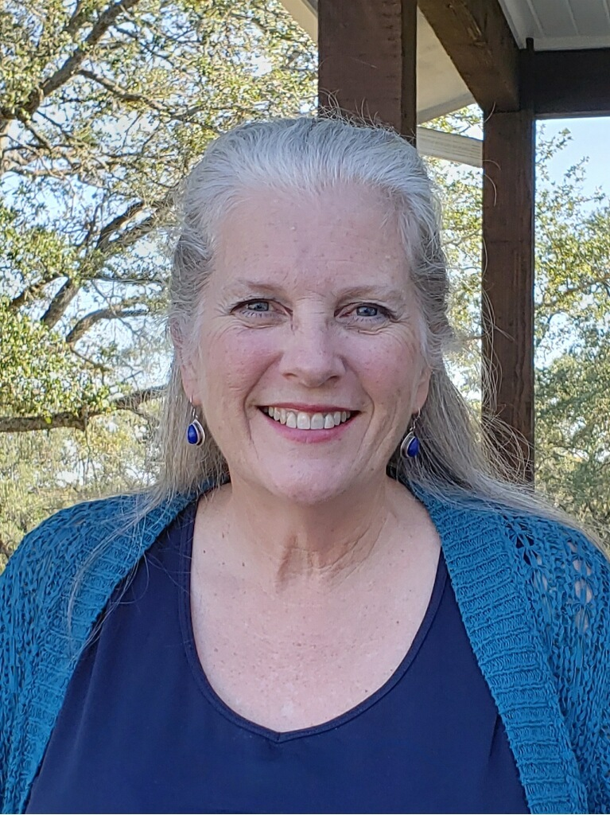

SHARON Rudolph
Director of Member Development
Unveiled Faces
(2 Corinthians 3:17-18) “Now the Lord is the Spirit, and where the Spirit of the Lord is, there is liberty. We all, with unveiled faces, are looking as in a mirror at the glory of the Lord and are being transformed into the same image from glory to glory; this is from the Lord who is the Spirit.” (https://biblehub.com/hcsb/2_corinthians/3.htm)
The story about Moses having to put a veil over his face because of the people’s fear is in Exodus 34:29-35. He lived in a visitation culture with God and his visitations left visible evidence of his connection with God – his face shone with God’s glory.
Jesus had a habitation relationship with His Father, and He taught the disciples to not be afraid of this type of relationship. You can check out Jesus’ prayer in John 17 for one example of His impartation of habitation to His disciples. Jesus took away the veil so we don’t need to be separated from God or hide our faces from the world around us.
What a privilege we have to be transformable and to reflect God’s glory. Transformation is the goal of all training in TWC. Each training track has evidences of transformation, starting with Foundations Stage 3, as the ultimate outcome of the time and effort put in to any training. Head knowledge is not the goal. Holy Spirit brings this glory to glory life to us and through us to others. Living with Unveiled Faces involves partnering with Holy Spirit to be transformed so ultimately the world around us will ask “Why are you different?”
My questions for you this month are tied to this glory to glory aspect of our journey with God and how we partner with Holy Spirit:
1-How is your training bringing this glory to glory transformation in your life?
2-What aspect of your training brings you closest to the Lord making your habitation visible?
3-What are you learning about partnering with Holy Spirit, the one who brings God’s glory that we reflect, in your training?
4-What does God’s glory look like shining through you?
©2019 The Warrior Class ©2019 Frontline This training journal is only for The Warrior Class members who may print it for personal use or share via email.
Written permission is required for any other use or purpose for part or all of its contents.

Slide 7
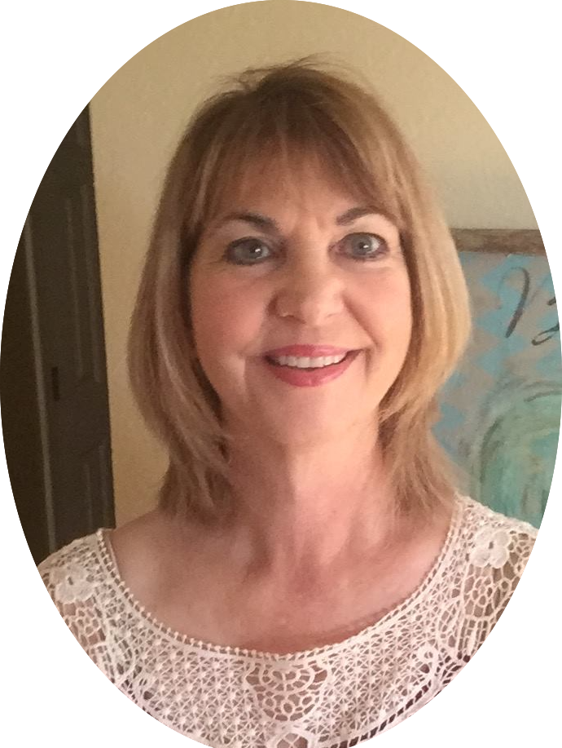
The Weapon of our Warfare: The Kiss of Intimacy
Angela Taylor
“Each ‘kiss’’ draws us into His stillness, beauty and glorious Presence, and arms us for battle.”
It was Good Friday. It was also my birthday. I was alone. My husband, in one of his silent, non-speaking moods had elected to spend the day out. I was not going to be upset. It was a beautiful day. I went, as I usually did on Good Friday, to the street witness at the cross in our small local town, taking a picnic with me to visit the beach afterwards.
Arriving at the beach the tide was in; I found a very warm, secluded corner, took out my picnic and book, prepared to enjoy being by myself, knowing that I had already asked God to give me something special for my birthday. I was expectant! He had never failed me! I savoured the warm sunshine, the gentle lapping of waves, and the general holiday feeling. Sometime later I saw a small, bright light, like a star, winking in a pool left by the retreating tide. Then I saw another, and another, until I had a small galaxy! I was drawn into them and God kissed me with His Presence. My birthday treat!
I have received many kisses from God, especially in really hard, difficult circumstances. I have had:
Thousands of ice crystals one Christmas Day when I was desperate and crying
Golden flowers on a heap of rubble
The shivery feeling of His physical touch when I am up in the early hours of the morning with Him
The liquid, musical song of a blackbird as it stands on the highest part of a tree
Deep peace amongst chaotic circumstances
Scriptures that leap off the page - the sound of His Voice
Provision before I even knew I needed something
Papa’s kisses are many and varied. From being kissed on the lips during worship (thanks Connie!), to discovering ‘heart images’. Each ‘kiss’ draws us into His stillness, beauty and glorious Presence, and arms us for battle. When we focus on Him and His love for us, nothing else matters, and we know ourselves Beloved.
©2019 The Warrior Class ©2019 Frontline This training journal is only for The Warrior Class members who may print it for personal use or share via email.
Written permission is required for any other use or purpose for part or all of its contents.

Slide 8

Look for these questions on Facebook. They come from our Frontline articles and are here to generate more conversation with our TWC Tribe. As you read Frontline, look at these questions and get ready to answer them over the next few weeks!
What did God show you during Worship Ebb?
How do you find ways to refresh yourself in your self-paced training modules?
What doors is God opening in you/for you right now?
What do you sense is shifting in the Church in this new season?
If you want to find a buddy group in TWC, post here. (on FB)
©2019 The Warrior Class ©2019 Frontline This training journal is only for The Warrior Class members who may print it for personal use or share via email.
Written permission is required for any other use or purpose for part or all of its contents.

Slide 9
TWC Training
Pacing
When we first start our adventure in TWC, we sprint into the training modules and try to be on every call available. Of course, we can’t keep that pace. Over time, we take a moment to breathe and realize the training modules are self-paced, which means we get to determine what that pace looks like.
As we continue in our warrior journey, we begin to add specialty trainings and grow by leaps and bounds. It all challenges us. We learn how to include training ebbs with our training flows and participate in what TWC offers. This keeps us on the cutting edge of what God is doing in us and through us. Learning to pace ourselves through the self-paced training modules in the midst of all this is a fantastic learning curve.
At times life happens and we can allow our focus on the self-paced training to stall a bit. Believe me, I’ve been there! In the eight years of my time in TWC, just about every life experience you can imagine has come my way: death of a loved one, elementary, junior high, and high school activities with my kids, extended mission trips, college moves, moves of parents, extended illnesses of loved ones, grief, several job changes for my husband, highest mountain moments and deepest valleys.
Just like many of our veterans, I’ve cried bucket loads of tears, pioneered several new areas, stretched, grown, felt growing pains, been wonky with upgrades and experienced amazing joy and breakthrough. I’ve faced tremendous amounts of warfare as I, my
specialty training groups and all of TWC dreamed, broke through and transitioned in many different areas. Whew! What a ride!
But, in all that time and with all those events, God draws me back to the self-paced training modules. He’s helped me realize, to train at the highest level, I can’t lose sight of what that training holds. Level training, advanced training, specialty trainings all hold incredible insights for us. If nothing else, they open the window of connection with God’s heart.
At times, I’ve thought a training module seemed simple on the surface: read that book several times, done that before, etc. But, as I opened my heart to what God wanted, I realized there was something in it that was needed.
I’ve had times when my training was actually revisiting a training I had already done.
What have I learned since then? How has my life changed and what perspectives do I have now?
Then, God would also show me something new. Other times, God helped me realize I needed to reset my schedule and block off some time for that training. No matter what, I have found the ability to refocus on my self-paced training brings a new place of growth, expansion and joy for the journey as I deepen in my relationship with God.
©2019 The Warrior Class ©2019 Frontline This training journal is only for The Warrior Class members who may print it for personal use or share via email.
Written permission is required for any other use or purpose for part or all of its contents.

Slide 10

Blueprint Response
Below is a letter of gratitude from one of our Blueprint recipients. We continue to work with and receive feedback from our first Blueprint recipients. They say they continue to return to their Blueprint again and again for prophetic insight. These Blueprints (our prophetic Intel/Intercession DO make a difference!
Dear Warrior community,
I’ve pulled away from my busy life with the intentionality of spending time in rest and meditation with the Lord through the scriptures and worship.
⚔️ Received multiple words conforming Hebrew 4 - Rest - along with pulling back from involvement in so many church activities.
⚔️ Looking forward to spending this time deepening in intimacy, rest and sonship.
⚔️ Received a prophetic word from Julian Adams a speaker at the Shawn Bolz Modern Prophetic Symposium held in Grand Prairie last month that - A shift is going to come in our ministry and there is going to be significant change. I feel the lord calling me into a deeper relationship (sonship) to accomplish this next season.
At this time I am purposely engaging with the Warrior Class Blueprint in which I’m following the formatted instructions.
Both my husband and I are anticipating growing....moving into sonship and having Christ formed in us to continue our race.
This Blueprint is virgin ground for me. A path I’ve not taken before.
Please keep my husband and I in your prayers. Us stepping into this next season is vital for our community transformation and pioneering a new way of reaching the people of God.
So appreciate the time the Warrior community and especially Christine and Karleigh have spent investing in us to further the advancement of His Kingdom.
The Lords Blessings to you all,
Recipients of TNC Blueprint
©2019 The Warrior Class ©2019 Frontline This training journal is only for The Warrior Class members who may print it for personal use or share via email.
Written permission is required for any other use or purpose for part or all of its contents.

Slide 11
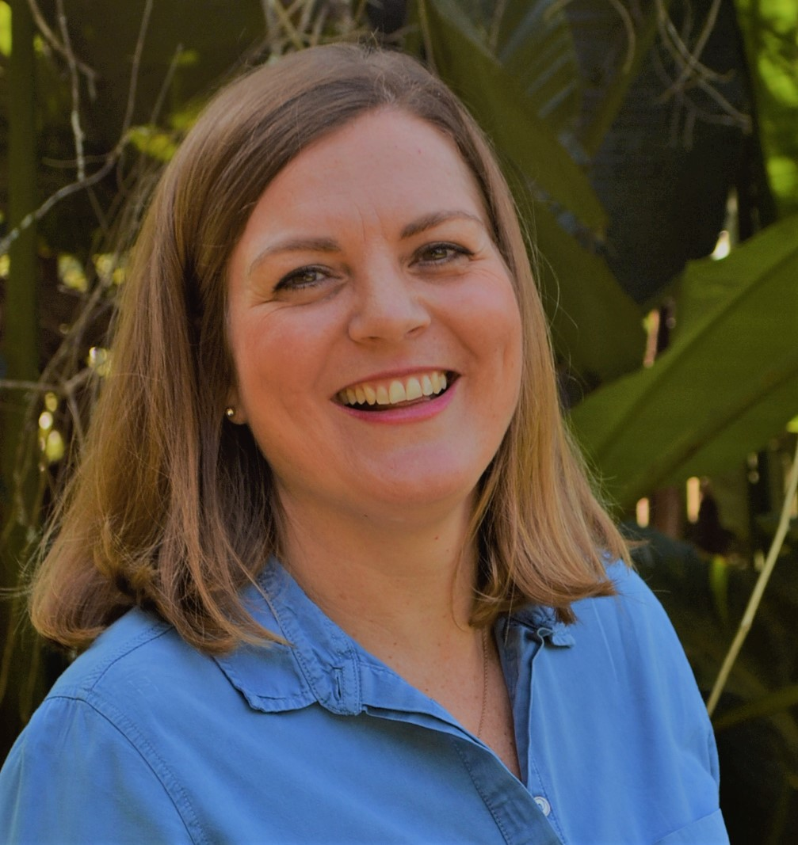
Member Spotlight
LindaSmallbones
My name is Linda. I am a born and bred South African, married to Gareth and we have a 9 year old son, Nicholas and 8 year old daughter, Gemma. As a family we love camping, the outdoors, the beach, the mountains, and music. My best places to connect with the Lord are in wild spaces and beautiful landscapes.
I have had the privilege of working and living in the UK in my twenties and over the last 4 years, the privilege of travelling to the USA several times to attend Graham Cooke’s conferences and attend TWC training days! Travel is in my blood and in my destiny, in 2014 just before my first Graham Cooke conference I was given the Scripture from Isaiah 52:7 “How beautiful on the mountains are the feet of those who bring good news, who proclaim peace, who bring good tidings, who proclaim salvation, who say to Zion, Your God reigns!” Travel got me in to TWC and this has been a huge passion of mine since the moment I became a member!
©2019 The Warrior Class ©2019 Frontline This training journal is only for The Warrior Class members who may print it for personal use or share via email.
Written permission is required for any other use or purpose for part or all of its contents.

Slide 12

Who We Are
The Warrior Class is a global community of passionate people who train together and pray together. It’s available from any location with internet access. We focus on the majesty of God to better understand and encounter our true identity in Christ. We tap into our unique training resources, coaching and community connection to rise up as Kingdom Warriors and create Crafted Prayers of Impact.
WHAT ARE THE PERKS YOU GET AS A WARRIOR IN THE WARRIOR CLASS? HERE’S A TASTE!
We have a unique community – unlike any other!
Connect – Transform – Re-imagine – Kingdom Life through God’s Eyes!
Process Focused Training Modules – unique to TWC and Kingdom Warrior training. Most are self-paced!
Access to Specialty Training – (Once Foundations training is complete)
Leadership Development – Developing and living a Kingdom culture of leadership
Team Coaching to support you in your training.
Dynamic Group Calls – share and hear warrior upgrades/transformation
Training Videos and WarriorTech Support
Access/Invites to local TWC gatherings
8+ years of archived resources – training articles, blogs and member highlights
Community Facebook interaction, conversations, videos and call recordings
Personal Feedback for each completed training
Intercession Projects (Blueprints) – Invitation to contribute 1-3x a year
Pray Impact Prayers – TWC wide and individually
Contribute to blogs and member articles – voluntary
Two Publications a month with more training, powerful questions, upcoming events, and articles from our warriors in many different roles.
Discounts – Warrior events, resources, etc.
Fun, excited, passionate community of Warriors seeking the more of God and the delight of seeing Him transform us into His image!
And many more!
We encourage you to enjoy this publication of The Warrior Class. We created it with you in mind to support you on your journey with the Lord.
You are welcome to print out a copy for your personal use and share it with friends or send it to them through email.
If you refer to this publication in a group or talk, please sight the source and share a little about TWC so others can hear more about us.
Stayed tuned for more ways to connect. We are in the process of creating new social media accounts for TWC. Currently we are posting on Facebook, Instagram, Twitter and will add a few more. We will post the information on how to connect soon.
©2019 The Warrior Class ©2019 Frontline
This training is only for The Warrior Class members who may print it for personal use or share via email. Written permission is required for any other use or purpose for part or all of its contents.

